Slide 1
Madrid Airbnb Data

Slide 2
INTRODUCTION
Airbnb has transformed the way people travel by providing an alternative to traditional hotel accommodations. The platform offers a diverse range of properties, including apartments, houses, and villas, that can be rented out by hosts to travelers.
Madrid, being a popular tourist destination, attracts a large number of visitors each year. The availability of affordable and comfortable accommodations on Airbnb has made it an attractive option for travelers visiting Madrid

Slide 3
Objective and goals of the project
Identify factors that influence rental prices of properties
Understand key drivers that affect rental prices
Develop a predictive model to estimate rental prices in Madrid
Assist hosts in optimizing their pricing strategies
Help guests make informed decisions about their accommodation choices
Provide insights into the broader housing market in Madrid

Slide 4
Data Exploration
Data collected from Inside Airbnb website
Independent and non-commercial set of tools and data
Provides information on Airbnb platform in various cities
Madrid Airbnb data includes: property type, neighborhood, room type, number of bedrooms/bathrooms, amenities, rental price, minimum/maximum nights required for stay, availability, number of reviews, and overall rating of the listing.

Slide 5
Data cleaning and preprocessing
Irrelevant data: removing duplicates and useless data increases precision of models and insights
Managing missing values: identifying missing values and handling them with imputation methods
Transforming categorical variables: converting categorical variables into numerical form with methods like dummy variables, label encoding, or one-hot encoding
Handle outliers: identifying and dealing with outliers through methods like removing them, changing them, or using robust statistical techniques

Slide 6
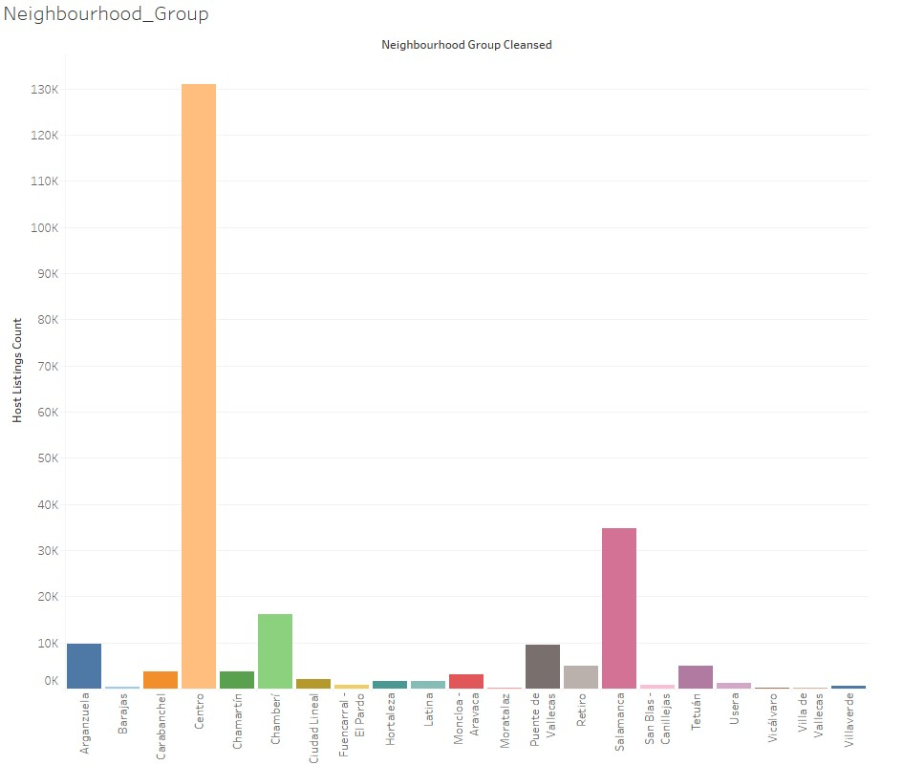
Data visualization
From graph is clear Centro Neighborhood have more number of listing then other

Slide 7
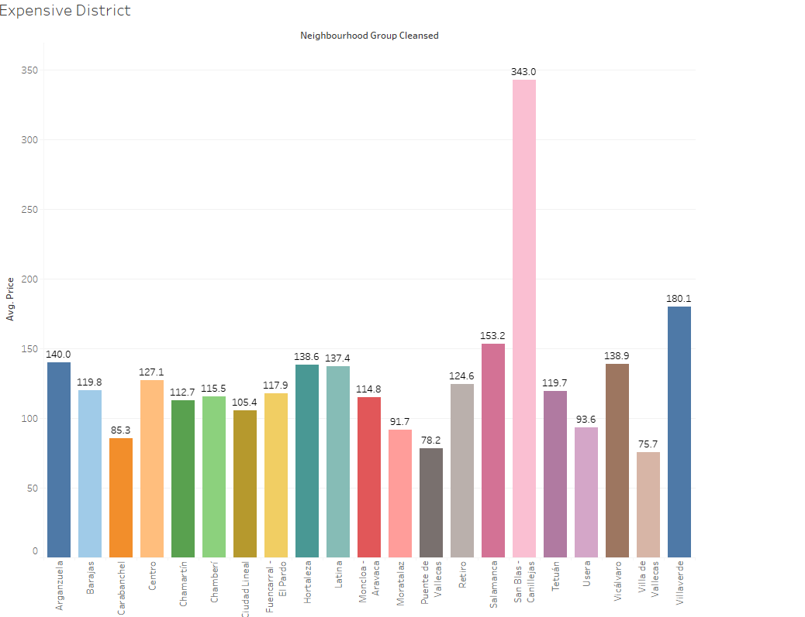
Data visualization
San Blas is Expensive District it is clear from graph

Slide 8
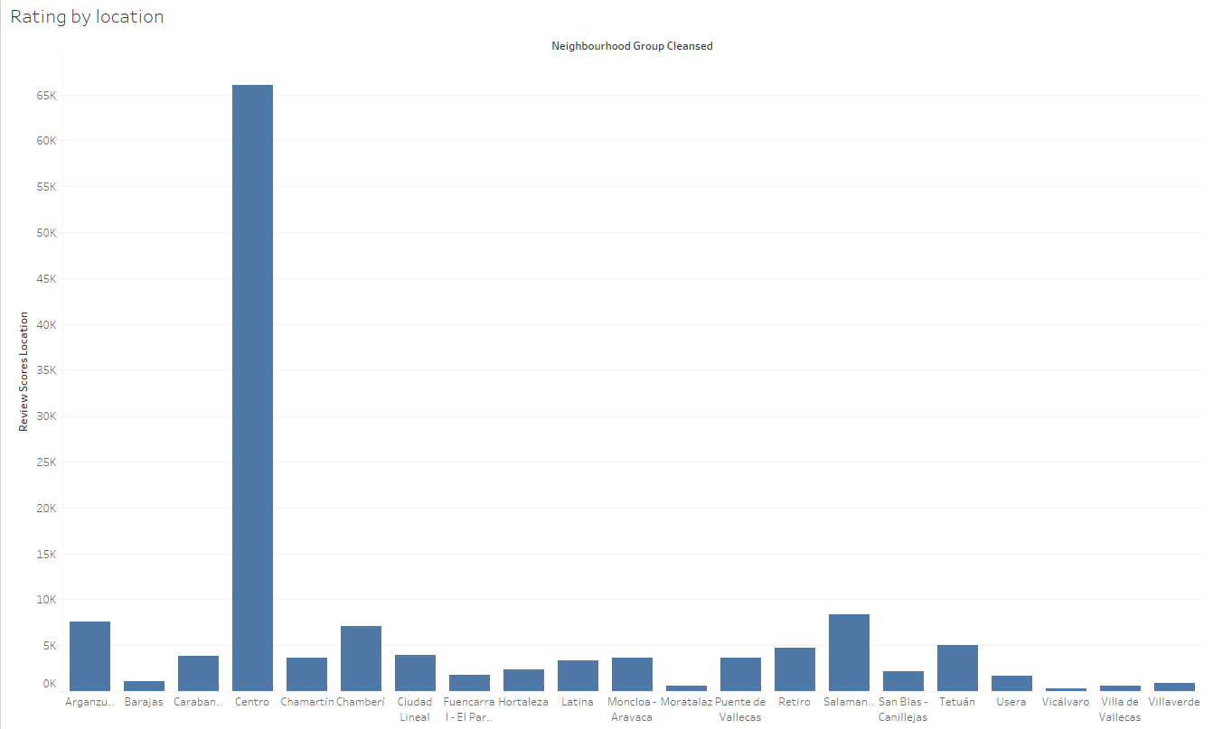
Data visualization
Centro Neighborhood is best neighborhood by listing

Slide 9
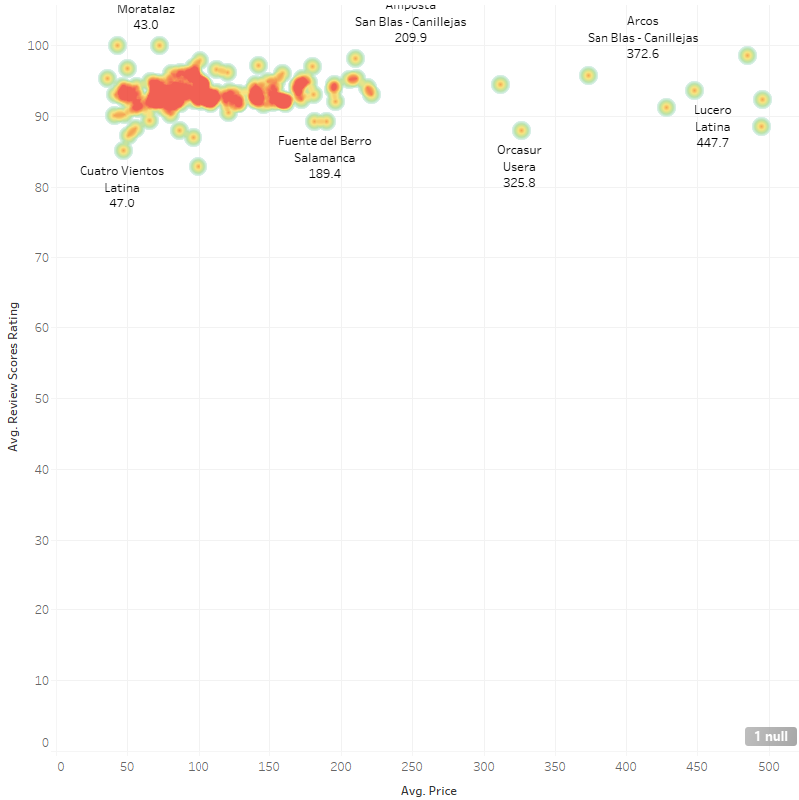
Data visualization
Price rating Density Plot showing prices and their rating" describes a type of data visualization that displays the distribution of prices and their associated ratings

Slide 10
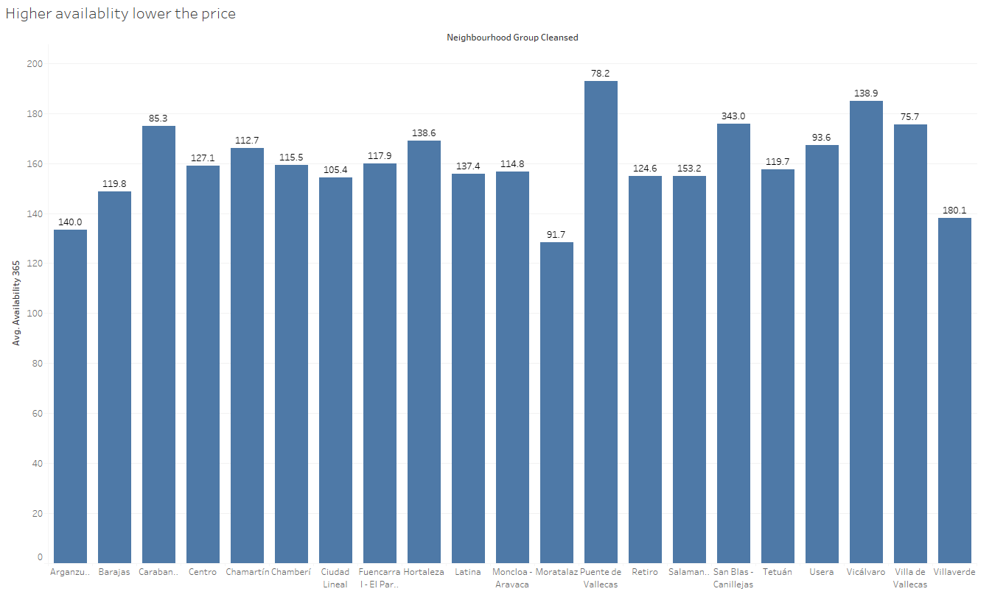
Data visualization
Here we can see the higher the availability lowers the price Puente de is highest availability

Slide 11
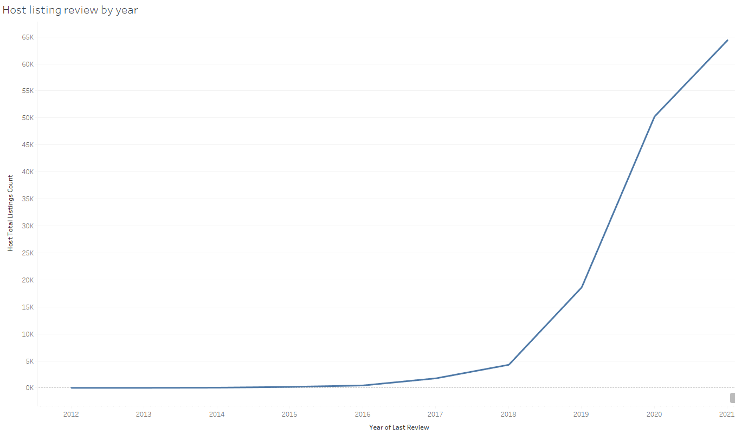
Data visualization
Host listing rating over the year increasing year by year

Slide 12
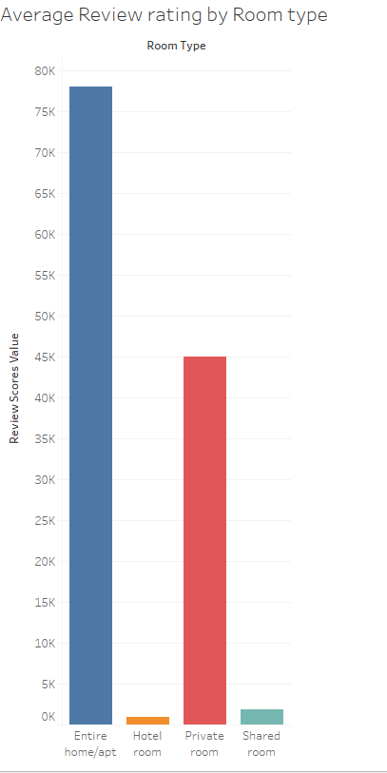
Data visualization
Average Review rating by Room type

Slide 13
Key findings from data exploration
Private space is preferred by visitors to Madrid
Location is an important factor in determining the price of a listing
Some hosts may be using Airbnb as a way to generate income
Properties in high demand are likely to be priced higher
Private rooms may be more popular or more commonly available than other types of listings

Slide 14
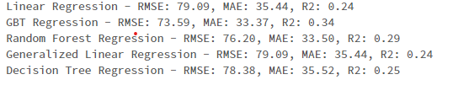
Methodology
This analysis uses multiple regression models like Linear Regression, Decision Tree Regression, Random Forest Regression, GBT Regression, and Generalized Linear Regression to predict a continuous variable.
The data is split into training and testing sets, each model is trained using the training data, and predictions are made on the test data using each model.
The performance of each model is evaluated using RMSE, MAE, and R2 metrics, and the RegressionEvaluator method is used to compute these metrics. The goal is to compare the performance of different regression models on the dataset.

Slide 15

Model selection and evaluation metrics
compares the performance of three regression models: Random Forest, Gradient Boosted Tree, and Decision Tree
Performance of each model is evaluated using RMSE, MAE, and R2 metrics
A metrics function is defined to compute and print RMSE, MAE, and R2 for a given model and predictions.

Slide 16

Hyperparameter tuning and optimization
Now we used to train and evaluate a Decision Tree Regression model using cross-validation with different hyperparameters to find the best model
Three evaluators are defined for RMSE, MAE, and R2 metrics. Finally, the cross-validator is instantiated with the pipeline, parameter grid, and RMSE evaluator

Slide 17
The output summarizes the performance of the model
The RMSE (Root Mean Squared Error) score of the model is 69.352. This means that the average difference between the predicted and actual prices is around $69.
The MAE (Mean Absolute Error) score of the model is 32.871. This means that the average absolute difference between the predicted and actual prices is around $33.
The R2 score of the model is 0.318. This means that around 31.8% of the variability in the dependent variable (price) can be explained by the independent variables used in the model.

Slide 18
Future work and potential extensions of the project
The current model used a limited set of features for the prediction of house prices. Incorporating additional features such as crime rates, proximity to public transport, and nearby amenities such as restaurants and parks could improve the model's accuracy.
Deep learning models: In regression problems, deep learning models like neural networks have shown encouraging results. The accuracy of the predictions could be increased using a deep learning algorithm.

Slide 19
Conclusion
Madrid Airbnb listings data through exploratory data analysis and compared the performance of multiple regression models such as Linear Regression, Decision Tree Regression, Random Forest Regression, GBT Regression, and Generalized Linear Regression. GBT Regression model was found to be the best-performing model. Further, hyperparameter tuning and optimization were done for the Decision Tree Regression model. The model evaluation results include RMSE, MAE, and R2 scores, with an RMSE score of 69.352, MAE score of 32.871, and R2 score of 0.318.

Slide 20
Thanks!

